Slide 1
Oh! What a Lovely Trade War?
Alan V. Deardorff
For presentation to Ford School Faculty Lunch, March 27, 2018

Slide 2
Source for most of this
http://www-personal.umich.edu/~alandear/news/TradeNews.html

Slide 3







Events in the News - 2017
Jan 20: Trump inaugurated
Jan 23: Trump pulls out of TPP
Jan 30:
Feb 27:
Mar 17:
Mar 31:
Apr 3: Trump signs 2 executive orders on trade
Apr 3:

Slide 4

Events in the News – 2017 cont.
CVD case begun under Obama
Apr 20: National security probe of steel imports
Apr 24: 20% tariff on Canada softwood lumber*
Apr 26: Trump “considers” pull-out of NAFTA
Apr 27: Trump decides not to pull-out of NAFTA
May 18: US launches NAFTA renegotiation
Jul 3:
Aug 14: Probe of China’s intellectual property theft
Oct 5: S. Korea agrees to amend FTA with US

Slide 5
Events in the News – 2018
Jan 21: US puts safeguard tariffs on solar panels and washing machines
Jan 28: Trump:
“I’ve had a lot of problems with European Union, and it may morph into something very big from that standpoint, from a trade standpoint.”
Feb 13: Trump contemplates “reciprocal tax”
May be legal under WTO Safeguards

Slide 6




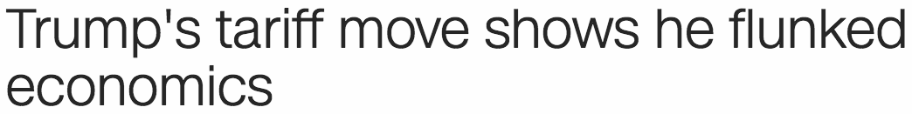
Events in the News – 2018 cont., Metals
Legality under WTO doubtful
Mar 1: 25% tariff on steel; 10% on aluminum
Mar 2:
Mar 2:\
Mar 2:
Mar 2:
Mar 3:
Mar 3:

Slide 7
Events in the News – 2018 cont., Metals cont.
Mar 8:
Mar 8: Trump metals tariffs to start in 15 days, exempting Canada and Mexico
Mar 22: Also exempts other allies EU, Australia, S. Korea, Brazil, Argentina (not Japan)
Mar 23 Tariffs go into effect, mostly on China and Russia

Slide 8
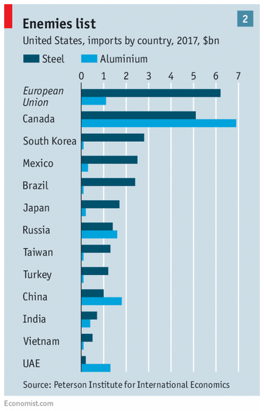
×
×
×
×
×

Slide 9
Events in the News – 2018 cont., China
Mar 22: Trump announces tariffs on $50-60 billion of China exports
Mar 22: China threatens tariffs on $3 billion of US exports
Mar 23:
Mar 24:

Slide 10
Trade War?
Is this a trade war? Or will it be?
Too soon to say
The safeguard tariffs on solar panels and washing machines were normal uses of trade laws
The national security tariffs on steel and aluminum were not normal, but were vastly scaled back to mostly China and Russia
The tariffs on China, just announced, are still unknown
Don’t know yet if there will be
Retaliation
Counter-retaliation

Slide 11
Trade War?
History of trade wars
Smoot-Hawley tariffs of the 1930s

Slide 12
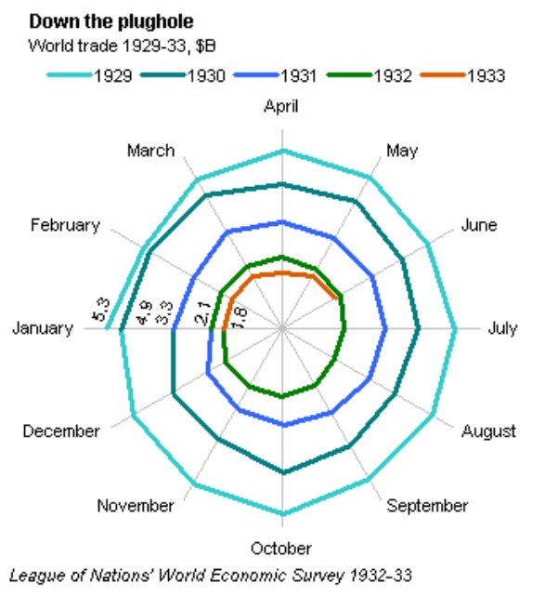
Kindleberger Spiral

Slide 13
Trade War?
History of trade wars
Smoot-Hawley tariffs of the 1930s
These were broader than any tariffs proposed so far
They did prompt retaliation
But (according to Doug Irwin)
The tariffs neither caused, nor were caused by, the Great Depression
More important than the tariffs were other policies, including exchange restrictions motivated by the Gold Standard

Slide 14
Trade War?
Other trade disputes
US-Japan in the 1980s
Didn’t have WTO (only the weaker GATT) to resolve problems
As allies, US and Japan had reason to find solutions
(This was where USTR Lighthizer earned his stripes)
Since WTO
Many disputes
All handled in WTO

Slide 15
Trade War?
The real dangers here:
The skirmish now could grow
But nobody (except Trump) wants that
News today is that China is promising changes
EC Chief Juncker:
“We can also do stupid.”
“We also have to be this stupid.”
WTO may become irrelevant
Future disputes will be worse

Slide 16
Addendum: Quote from Trump
Told by Canada's Justin Trudeau that Canada doesn’t have a trade surplus with the US, Trump says "I said, 'Wrong, Justin, you do.' I didn’t even know. I had no idea."
In fact, by US data, the US has a surplus with Canada in goods and services, but a deficit if you count only goods. 2017, $billions:
Goods: –17.5
Goods and services: +2.8
As economists explain, there is no reason why countries’ trade should balance, especially bilaterally, under either measure.

Slide 17
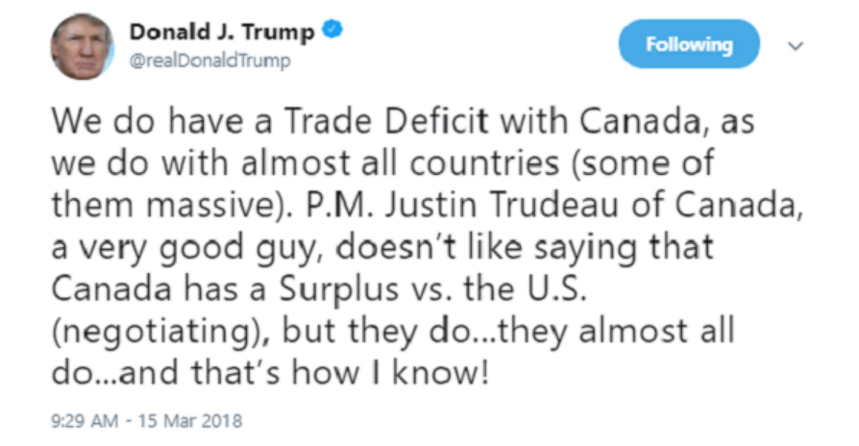
Quote from Trump:

Slide 18
Is he right about “almost all countries”?
US Census reports goods trade balances of US with 234 countries for 2017. US has
Surpluses with 130
Deficits with 104
But with our top-10 trading partners (ranked by exports plus imports) we have a surplus with only one: U.K.
Of our top 50 partners, we have surpluses with only 36%

